Slide 1

HUMAN ACTIVITY RECOGNITION USING
LSTM NEURAL NETWORKS
Subramanian Sivaraman & Sushmita Sivaprasad
MS in Data Science

Slide 2
Content
Practical Applications
The Dataset
Implementation
Results
Challenges and Future Work

Slide 3

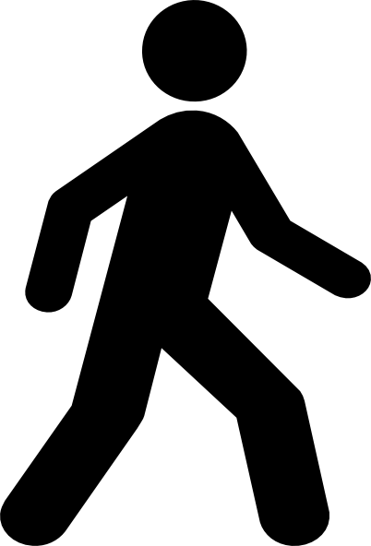


Practical Applications
Commercial: Activity tracker
Military: Activity patterns recognition combined with location to improve personnel safety and track performance
Hospitals: Remotely monitor a patient’s activity; detecting accidents (trips/falls) and abnormal behavior
A Survey on Human Activity Recognition using Wearable Sensors
http://citeseerx.ist.psu.edu/viewdoc/download?doi=10.1.1.224.9632&rep=rep1&type=pdf
Notes:
This is the main problem we are trying to solve

Slide 4
The Dataset
Data captured using accelerometer and gyroscope from a smartphone
3-axial linear acceleration and 3-axial angular velocity data for 30 people performing static, dynamic and postural transitions
10929 instances and 561 features
Sampling performed using fixed sliding windows of 2.56 sec and 50% overlap (128 timesteps/window)
Angular velocity (gyroscope) data is split into gravitational and body motion components using a Butterworth low-pass filter
UCI Machine Learning Repository
https://archive.ics.uci.edu/ml/datasets/Smartphone-Based+Recognition+of+Human+Activities+and+Postural

Slide 5
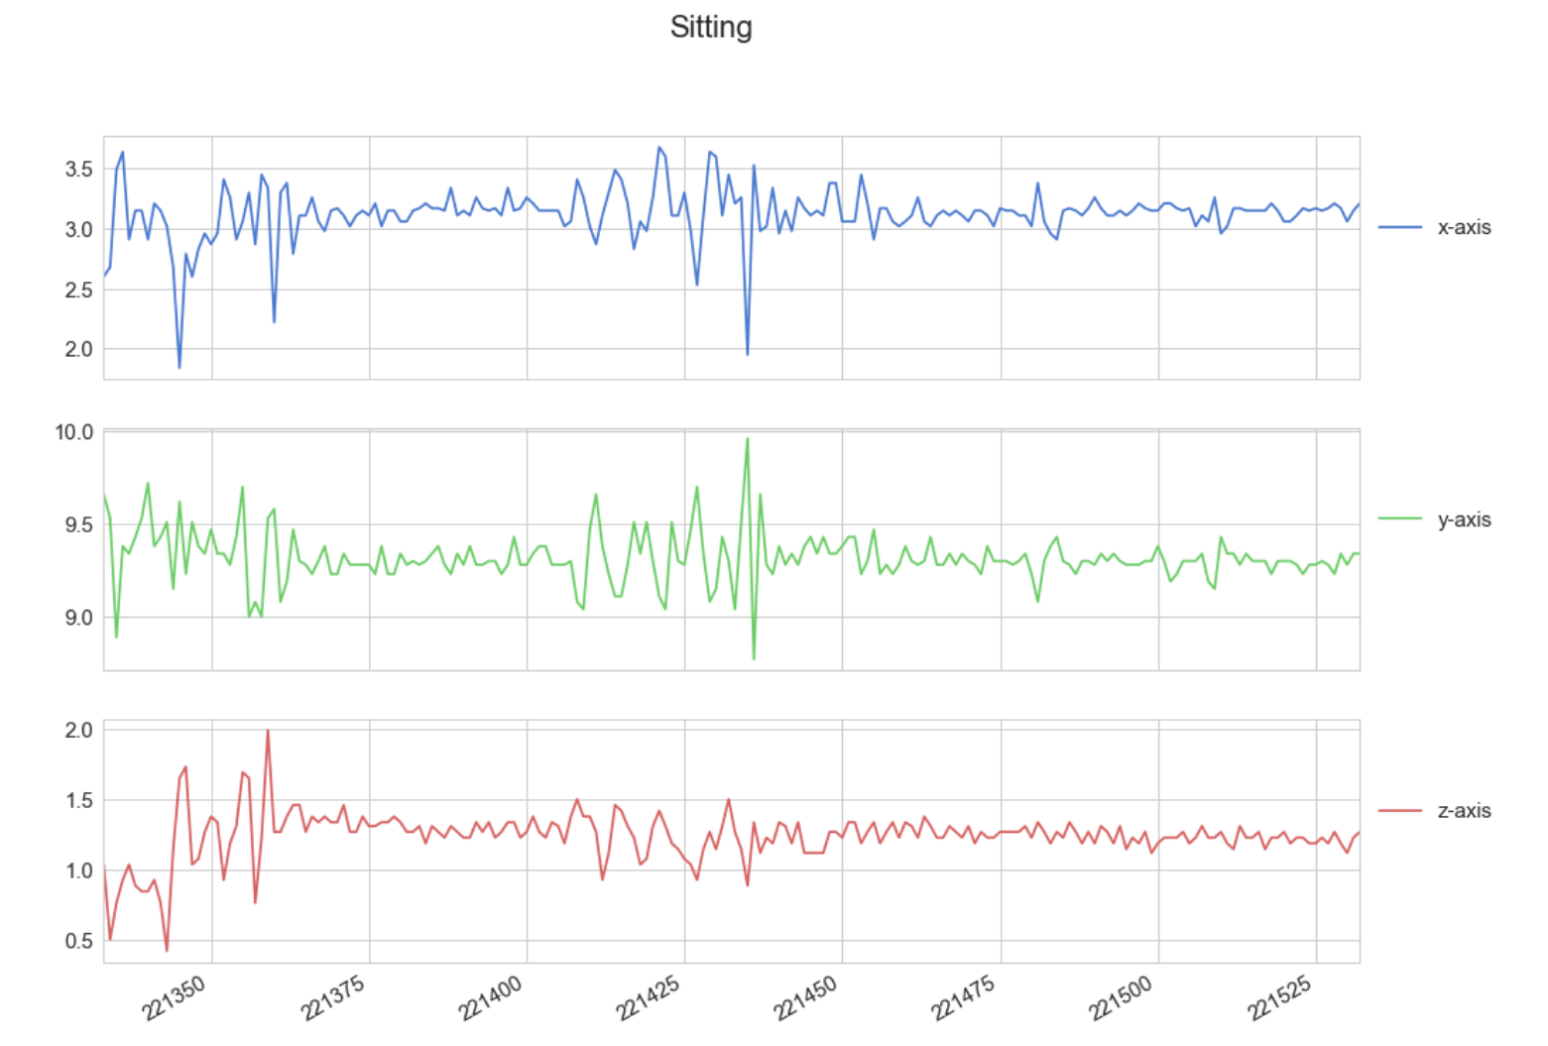
The Dataset
https://github.com/curiousily/TensorFlow-on-Android-for-Human-Activity-Recognition-with-LSTMs/blob/master/human_activity_recognition.ipynb

Slide 6
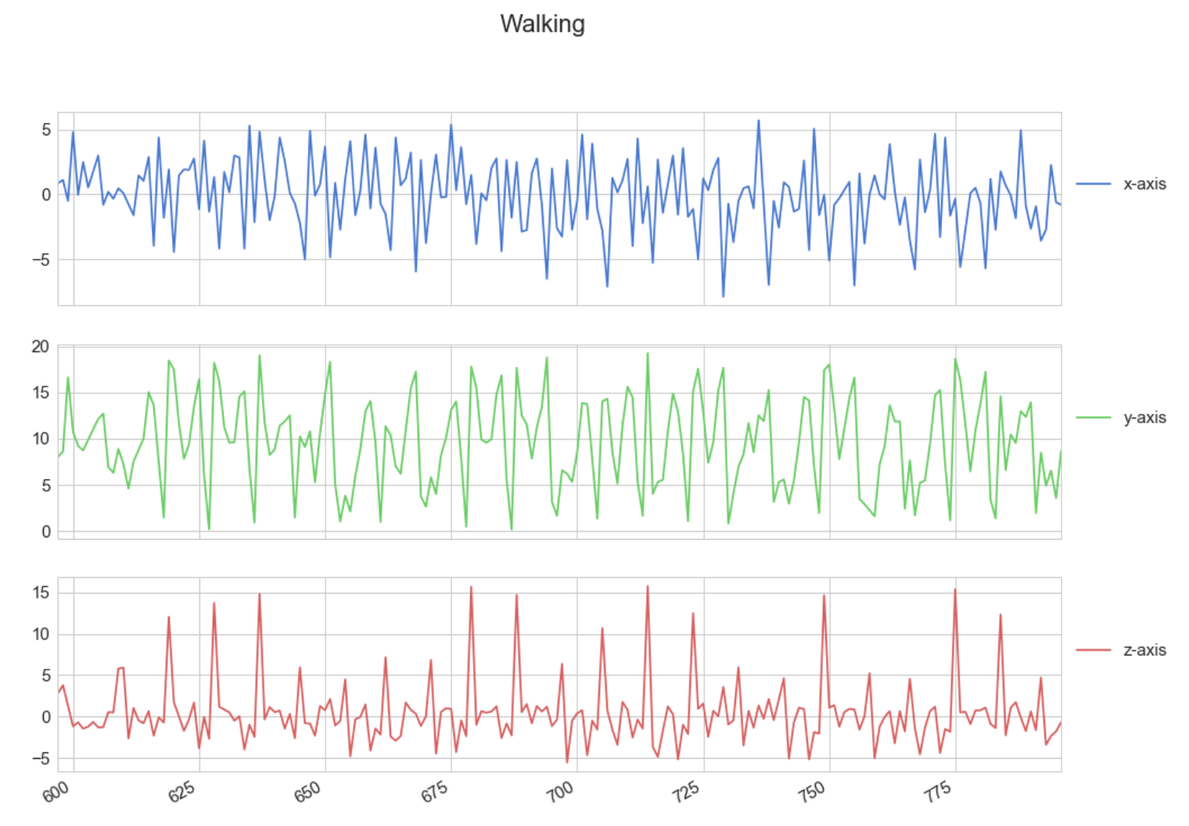
The Dataset
https://github.com/curiousily/TensorFlow-on-Android-for-Human-Activity-Recognition-with-LSTMs/blob/master/human_activity_recognition.ipynb

Slide 7
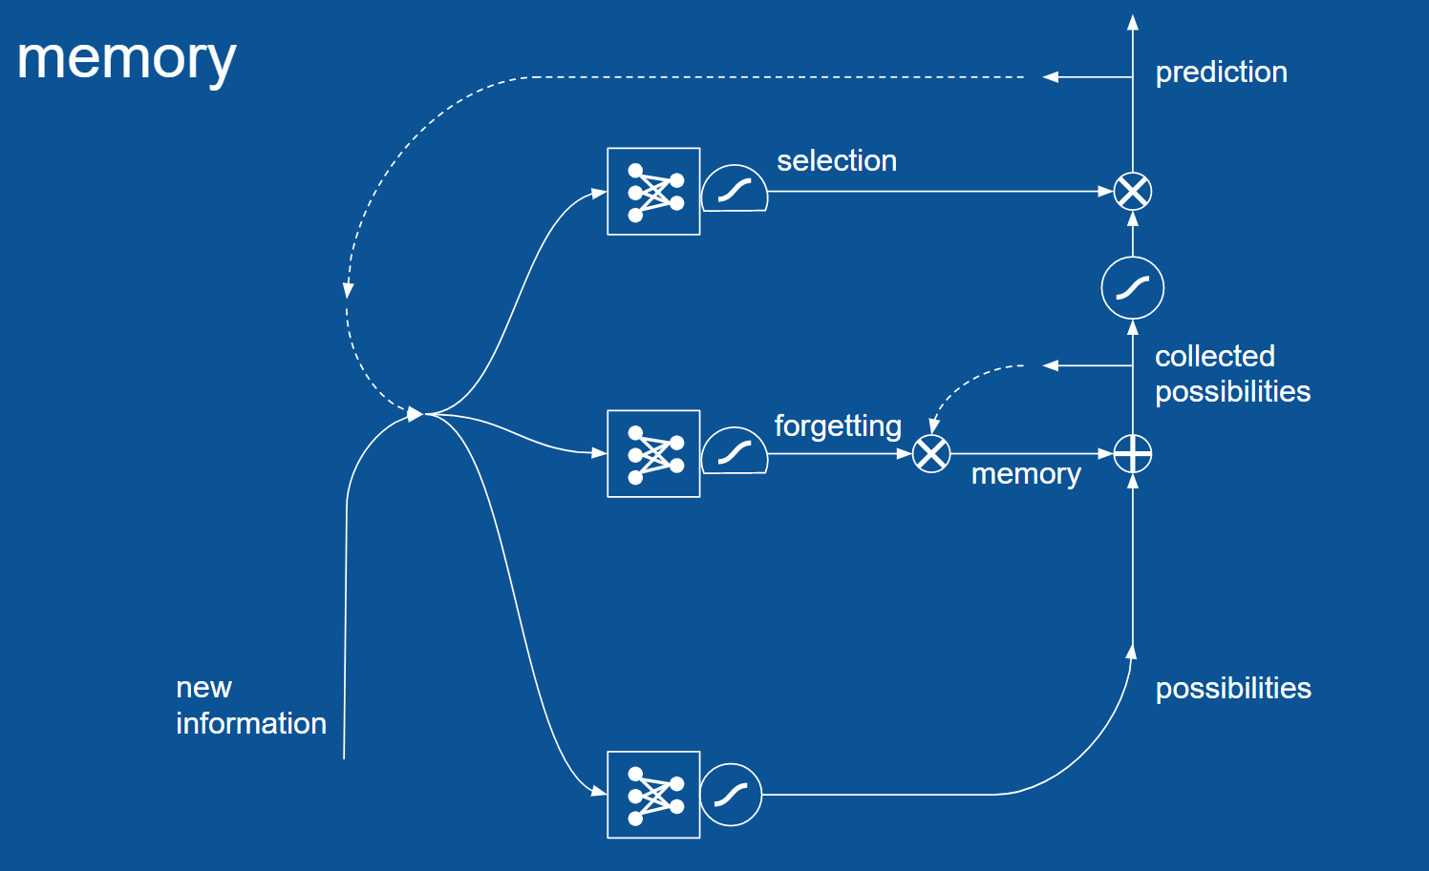
Implementation - LSTM
A type of RNN with gates to control memory and selection
LSTMs require almost no feature-engineering as long as the data is well pre-processed.
Reduces the vanishing /exploding gradient problem

Slide 8
Results
Neural network with 2 LSTM cells (hidden layers)
Accuracy of ~85% on the Test dataset
Common classification errors are between sitting and standing & walking upstairs and downstairs
Turns out that the test dataset is very similar to the training set.

Slide 9
Challenges
Tracking activities on a smartphone needs to be instantaneous and accurate to be practically useful.
This demands the code to be highly efficient and the model’s prediction to be precise.
The dataset is the result of a controlled experiment; it may not be truly representative of real-world data.

Slide 10
Future Work
Improve accuracy and speed – Hyperparameter tuning
Extend this implementation to identify postural transitions – Stand to sit, Sit to lie, Stand to lie and vice versa
Try alternate approaches like Gated Recurrent Units (GRUs) and SVMs

Slide 11
Thank you!
Questions?

